Slide 1
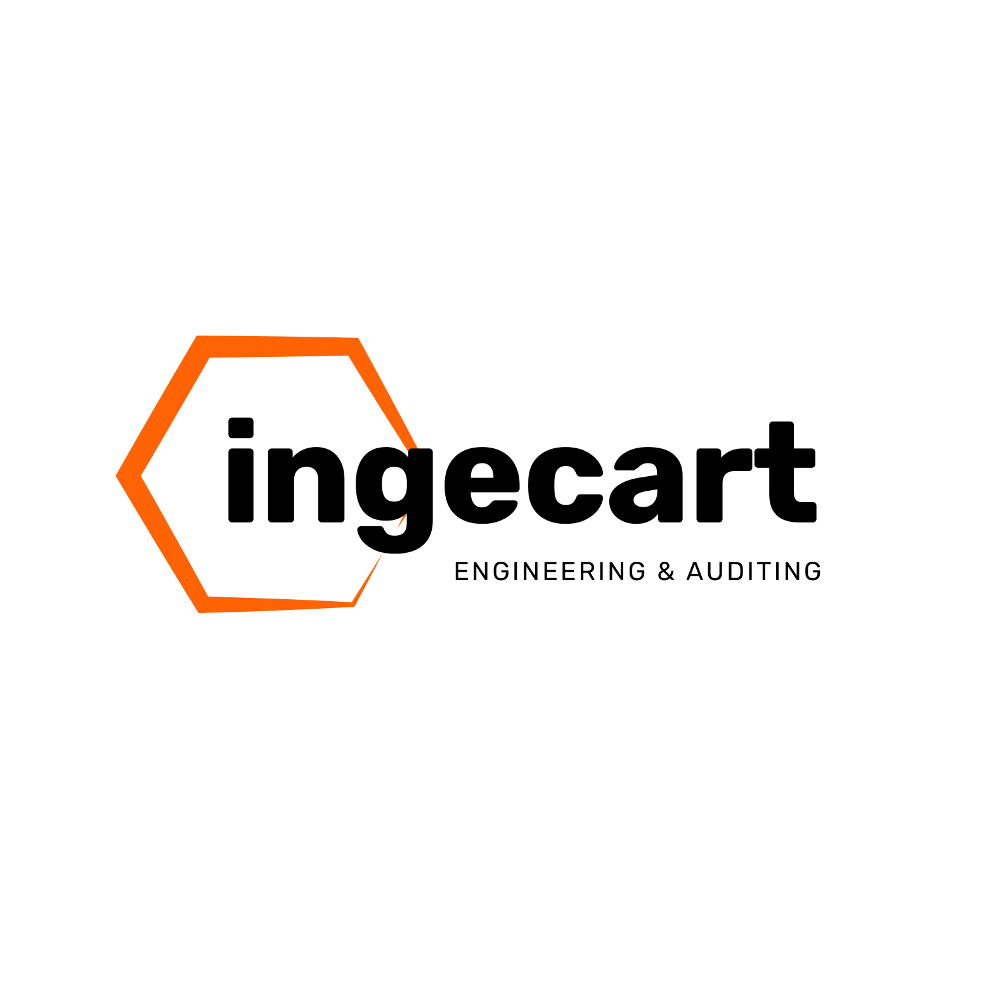
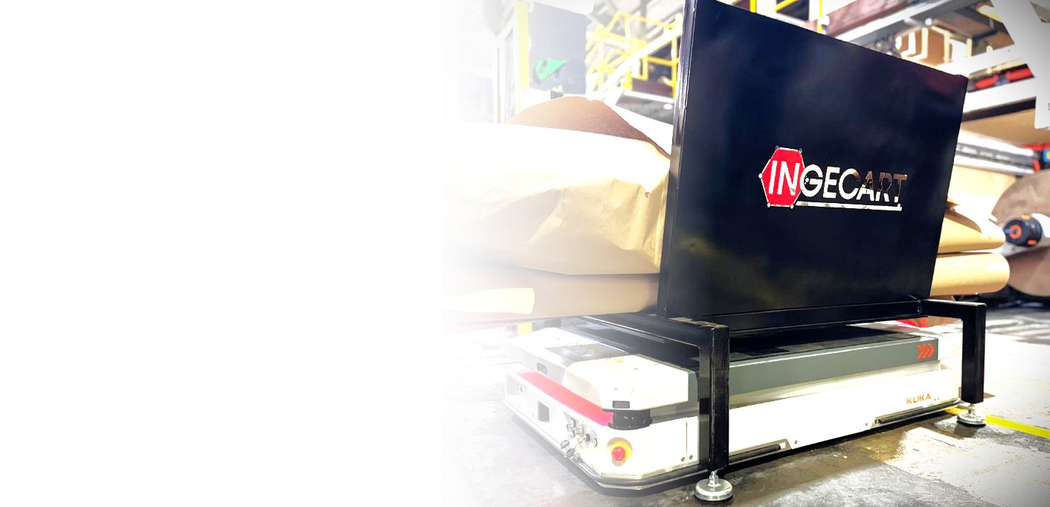
INTRALOGISTICS
AMR
INTRALOGISTICS
AMR
Supported by KUKA, Ingecart has develop
a unique automated system for improving
the WIP management, efficiency
precision cost reduction .

Slide 2
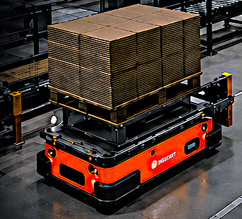
Ingecart Intralogistics Management System
AMR-Based Solution
Ingecart Intralogistics Management System – AMR-Based Solution
Automate. Optimize. Maximize Every Square Meter.
Autonomous Mobile Robots (AMRs) significantly increase efficiency in storage and production environments. They automate transport and logistics processes, accelerating task execution and optimizing goods flow.
Ingecart's compact and flexible AMR models integrate seamlessly into existing supply chains – saving substantial time and resources.

Slide 3
Ingecart Intralogistics Management System
AMR-Based Solution
Fully automated movement of loads, WIP, and finished goods between warehouse, production, and converting machines
Real-time communication with production planning systems
📦 Logistics Efficiency
Just-in-time delivery of materials to converting stations
Reduced waiting times and improved overall equipment effectiveness (OEE)
Synchronized material flow aligned with production pace
📐 Maximum Space Utilization (WIP per m²)
Compact AMR design navigates narrow aisles and tight spaces
Optimized WIP placement in minimum footprint
Intelligent routing allows higher storage density without adding square meters
🔁 Flow Management Between WIP & Converting Machines
Dynamic management of work-in-progress buffers

